Slide 1



Cloud 9 Superstore data analysis report dashboard
View in Power BI
Last data refresh:
22/02/2023 13:03:31 UTC
Downloaded at:
22/02/2023 13:04:43 UTC

Slide 2
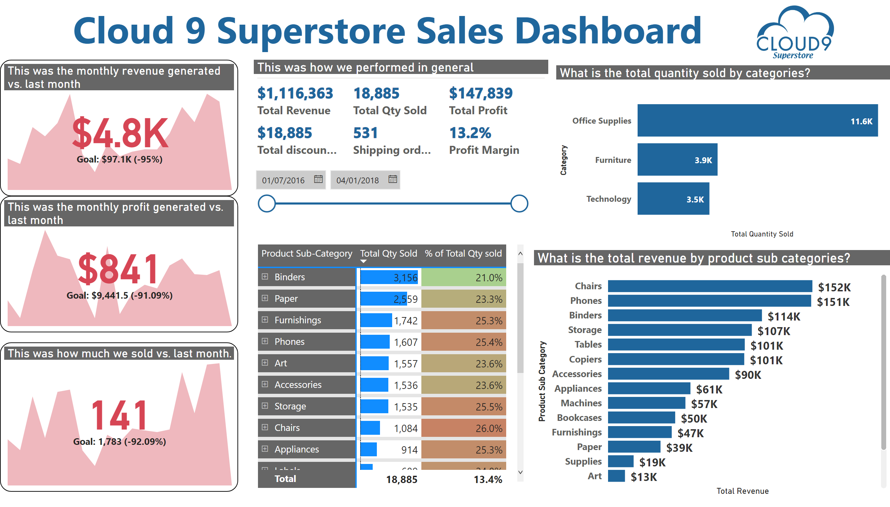
Executive Report
Notes:
image
No alt text provided
image
No alt text provided
pivotTable
No alt text provided
This was how we performed in general
No alt text provided
This was how much we sold vs. last month.
No alt text provided
This was the monthly profit generated vs. last month
No alt text provided
This was the monthly revenue generated vs. last month
No alt text provided
What is the total quantity sold by categories?
No alt text provided
slicer
No alt text provided
What is the total revenue by product sub categories?
No alt text provided
textbox
No alt text provided

Slide 3
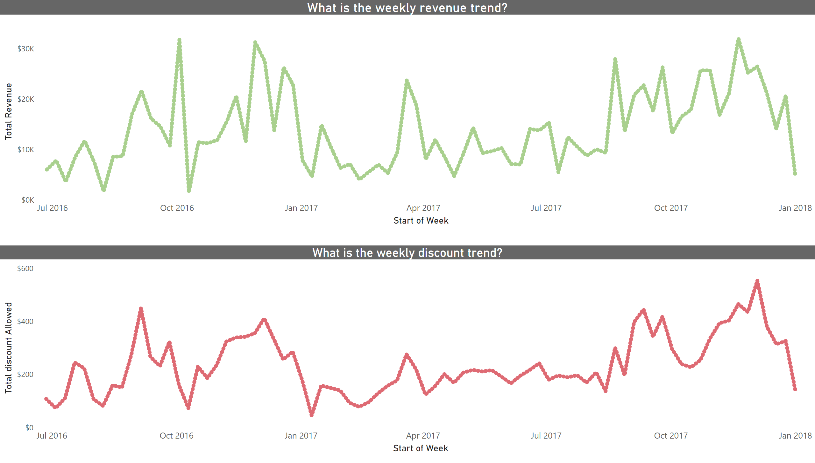
Time Series Report
Notes:
What is the weekly revenue trend?
No alt text provided
What is the weekly discount trend?
No alt text provided

Slide 4
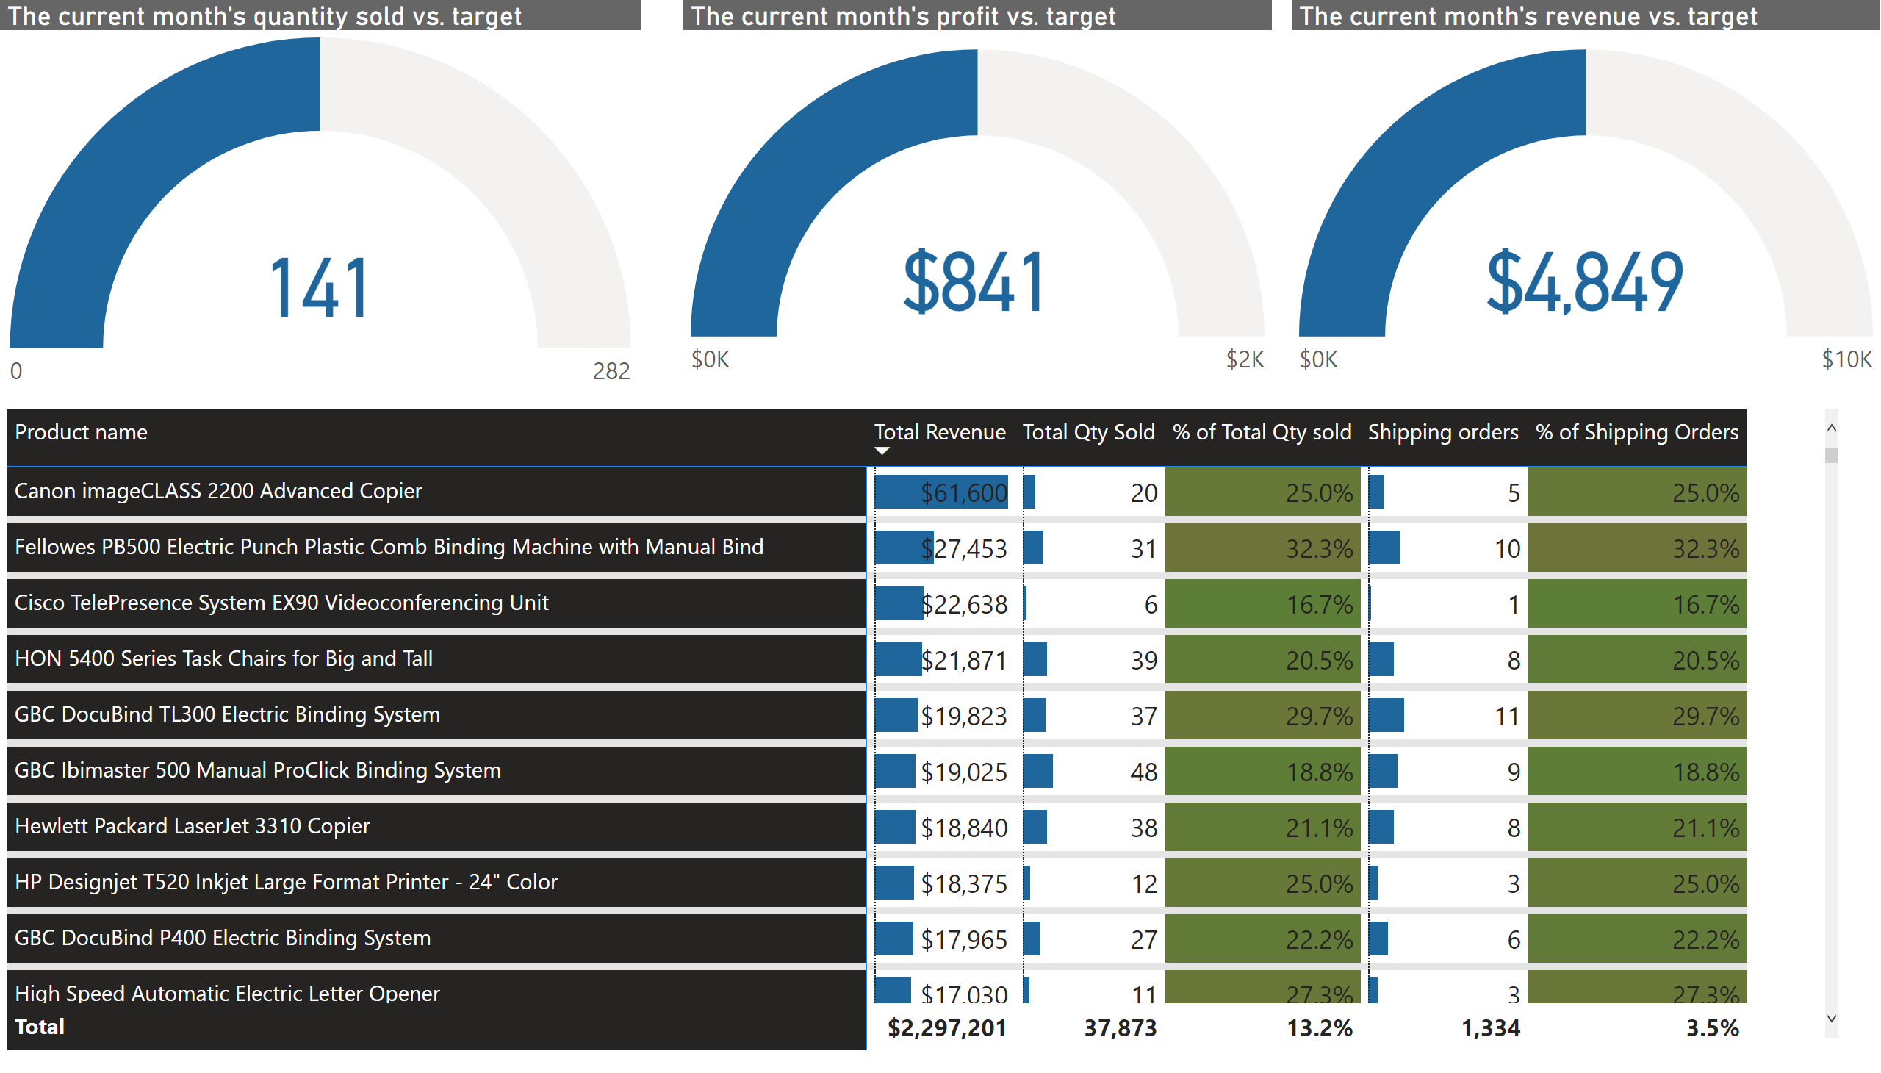
Product Report
Notes:
The current month's quantity sold vs. target
No alt text provided
The current month's profit vs. target
No alt text provided
The current month's revenue vs. target
No alt text provided
pivotTable
No alt text provided

Slide 5
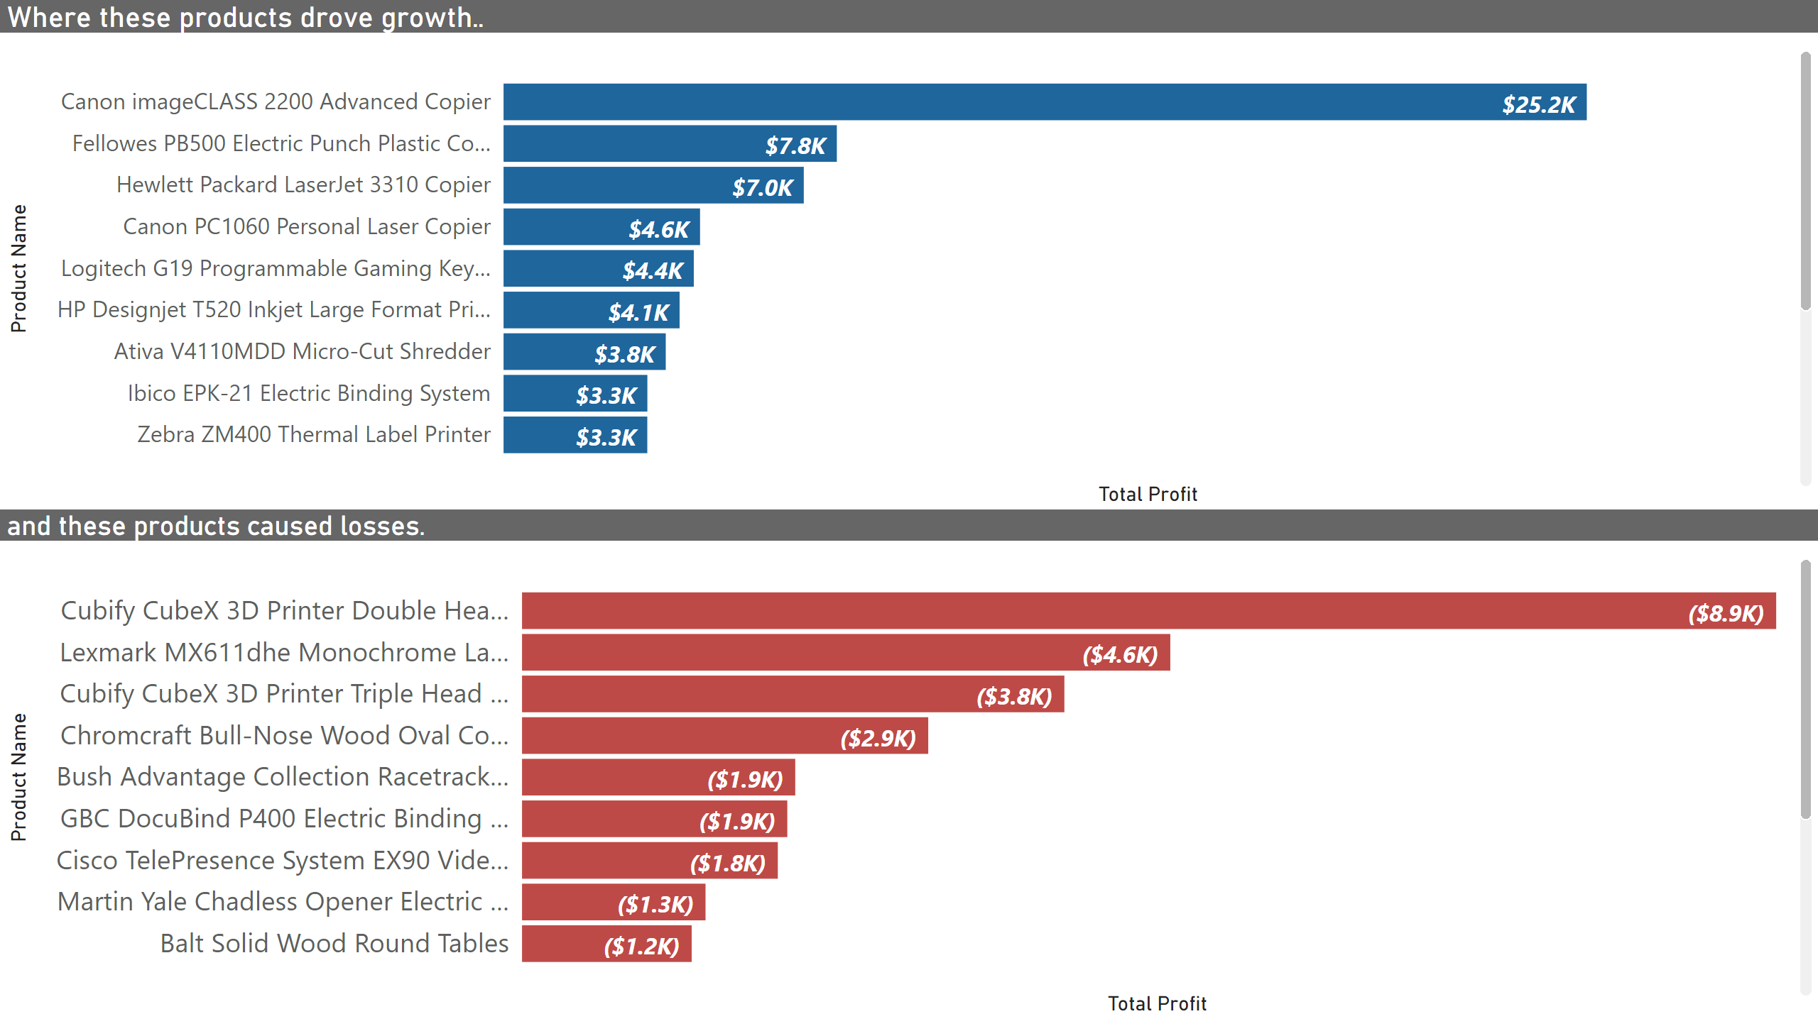
Top & Bottom performing Products
Notes:
Where these products drove growth..
No alt text provided
and these products caused losses.
No alt text provided

Slide 6
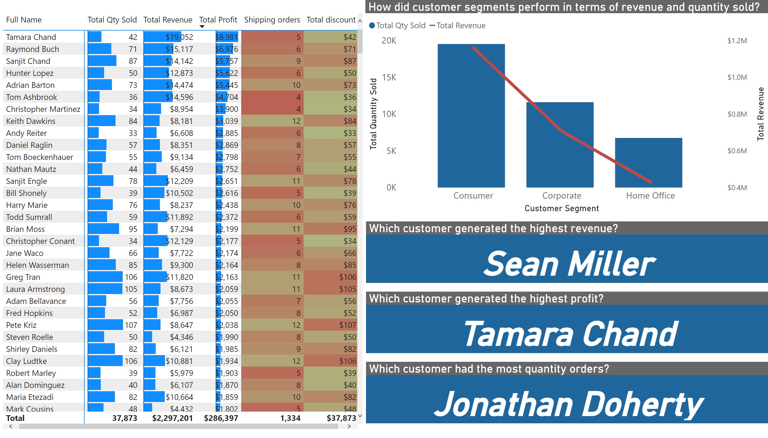
Customer Report
Notes:
pivotTable
No alt text provided
Which customer had the most quantity orders?
No alt text provided
Which customer generated the highest profit?
No alt text provided
Which customer generated the highest revenue?
No alt text provided
How did customer segments perform in terms of revenue and quantity sold?
No alt text provided

Slide 7
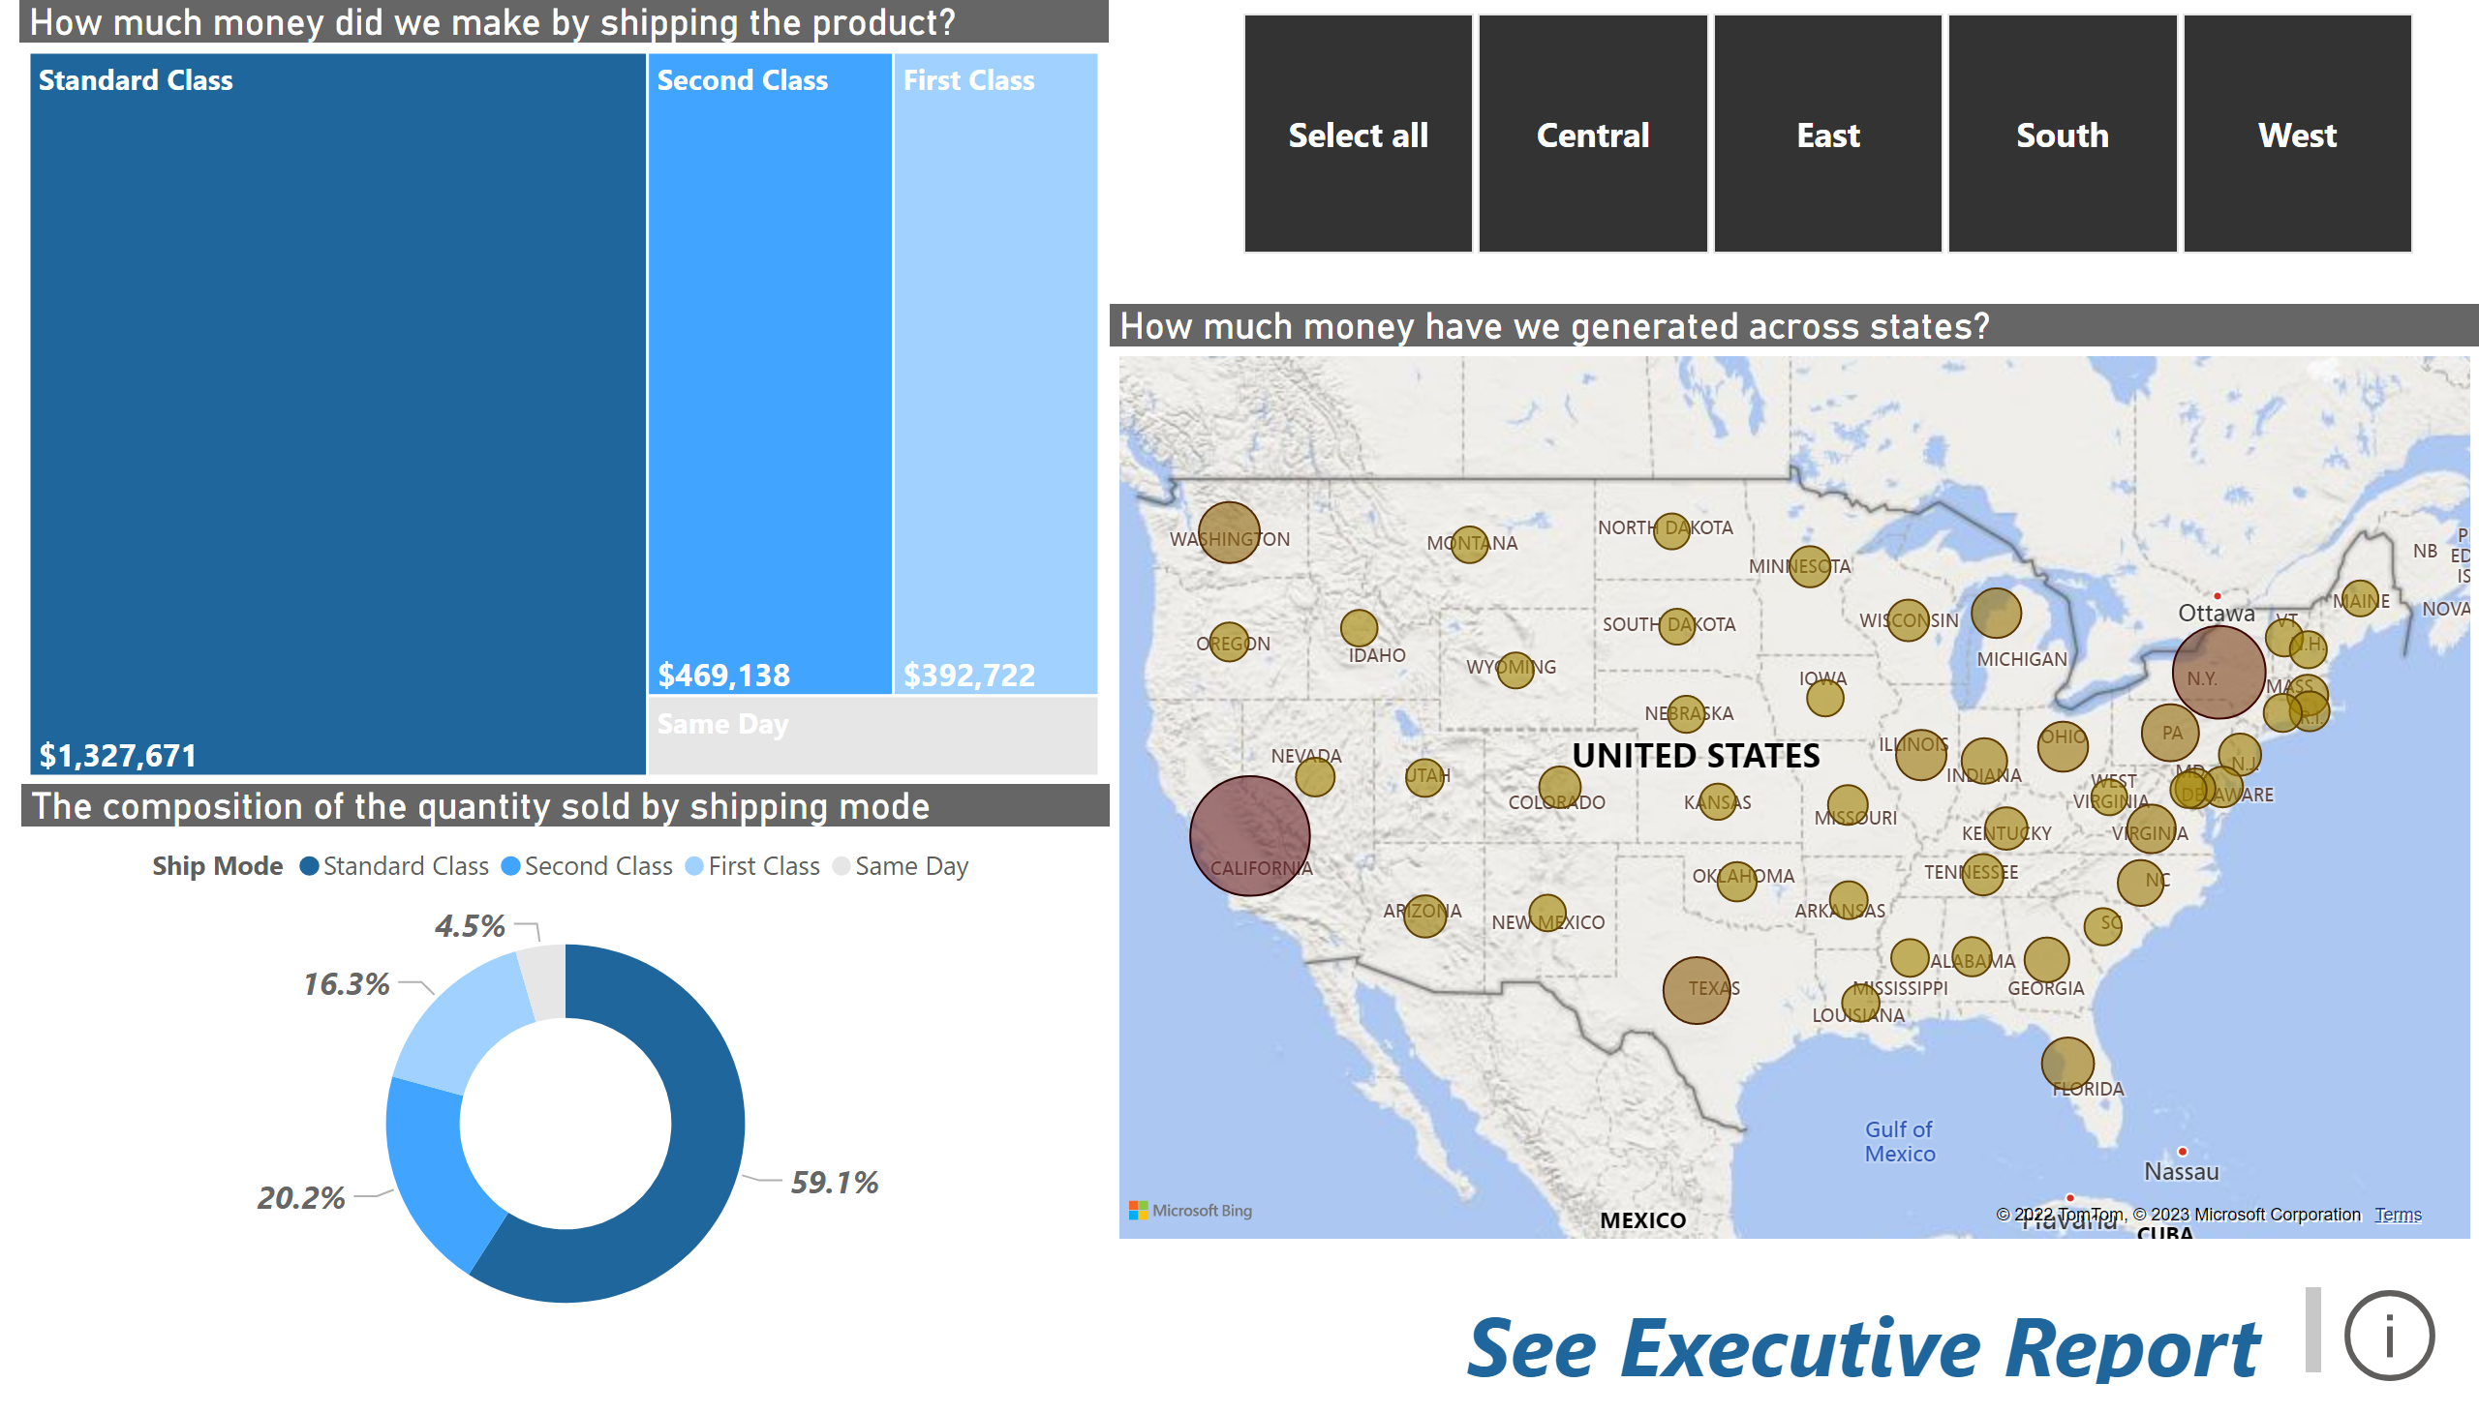
Region and Shipping Report
Notes:
How much money have we generated across states?
No alt text provided
How much money did we make by shipping the product?
No alt text provided
slicer
No alt text provided
The composition of the quantity sold by shipping mode
No alt text provided
actionButton
No alt text provided
textbox
No alt text provided

